Slide 1
Unzipping the metagenome:
strain-level discovery in the gut microbiome
Byron J. Smith
Bioinformatics Fellow
Notes:
Good afternoon!
For those of you I have not met, I'm Byron;
I'm a postdoc in Katie Pollard's lab
It's my honor to be the last trainee talk of the retreat
Thank you all for being here, awake, and curious.
Today I'm excited to tell you about some research in progress
a computational tool that I'm developing
for assembly of short-read, shotgun metagenomes
as well as a couple of preliminary results
from applying it to samples from the human gut microbiome.

Slide 2
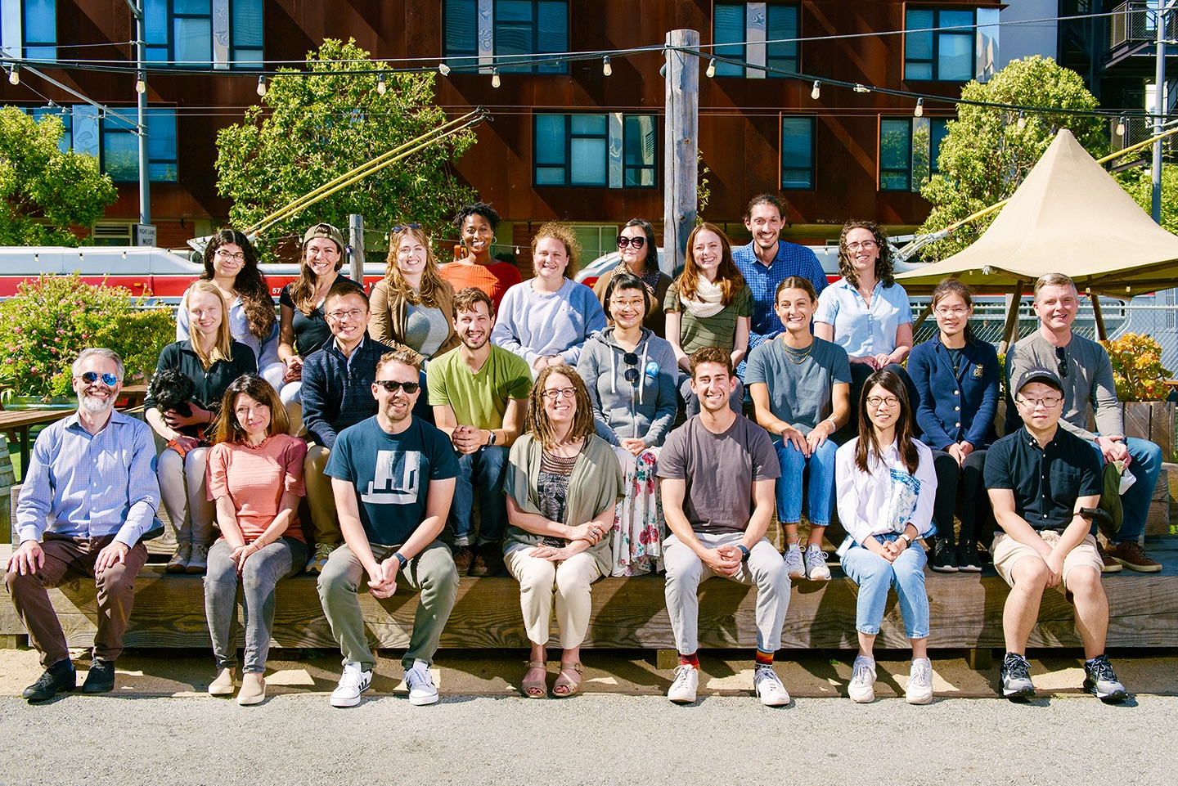



First Thing:
Thank You!
Pollard Lab
Katie Pollard Veronika Dubinkina
and everyone
Collaborators
Archit Verma
Dylan Cable
Funders
Gladstone Institutes
NIH
CZ Biohub
UC Noyce Initiative
Helmsley Charitable Trust
Notes:
I also want to start by acknowledging
all of the colleagues, collaborators and funding sources
that have supported me for the last five years
without whom this work would not be possible.

Slide 3
Introduction: The gut microbiome and
shotgun metagenomics
Notes:
Okay, first-things-first:
I'm going to give you a very abbreviated introduction to
the gut microbiome and shotgun metagenomics
and tell you about why I find this field so challenging and so exciting.

Slide 4
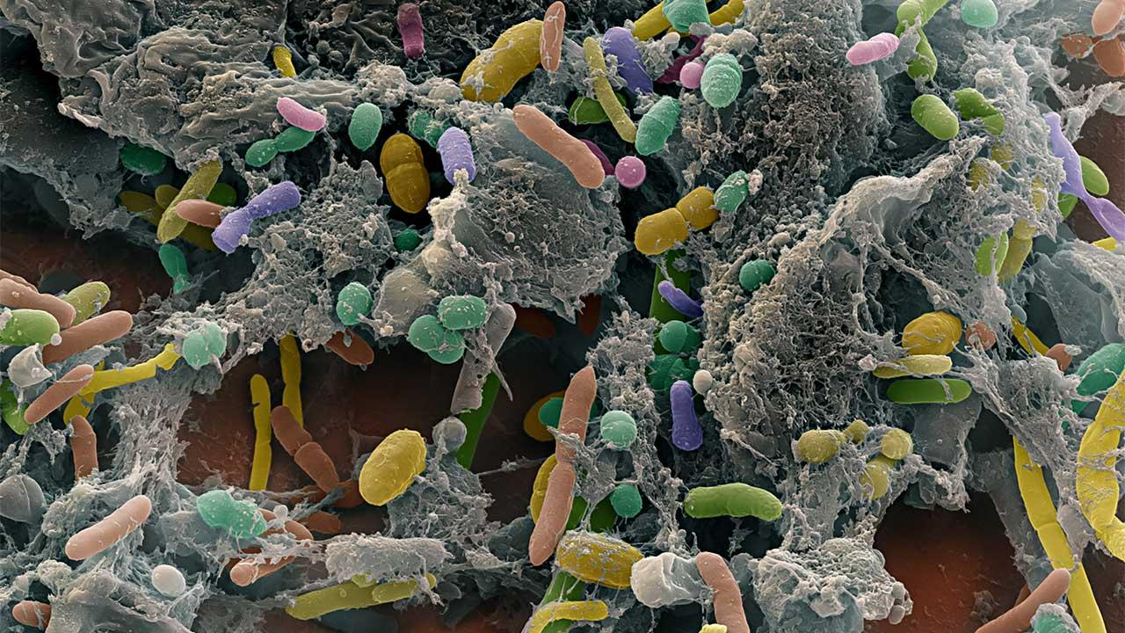
The Gut Microbiome is Challenging
Notes:
It boils down to the enormous diversity in the microbes that inhabit our guts

Slide 5
The Gut Microbiome is Challenging
Enormous number of species
Notes:
including hundreds of species per individual and thousands across the human population

Slide 6
The Gut Microbiome is Challenging
Enormous number of species
Highly dynamic across people and time
Notes:
The system overall is highly dynamic, with major variation across individuals and over time
and tons of physiological and ecological interactions

Slide 7
The Gut Microbiome is Challenging
Enormous number of species
Highly dynamic across people and time
Very hard to study in the lab
Notes:
As a result, it is very hard to study the microbiome using traditional microbiology techniques
and many species have never been isolated and grown in the lab.

Slide 8
The Gut Microbiome is Challenging
Enormous number of species
Highly dynamic across people and time
Very hard to study in the lab
Strains within species have different gene content and functional potential
Notes:
What's more, different strains within a species can have different gene content and therefore functional potential,
and the total number of strains seems to be truly staggering

Slide 9

The Gut Microbiome is Challenging
Enormous number of species
Highly dynamic across people and time
Very hard to study in the lab
Strains within species have different gene content and functional potential
Notes:
So how can we study this important system and the role of strain diversity?

Slide 10
Bacterial genomes are key to understanding strain diversity
Notes:
My answer for you today, is that microbial
genomics and computational methods are the key to understanding
the causes and consequences of enormous strain diversity in the gut microbiome

Slide 11
Bacterial genomes are key to understanding strain diversity
Notes:
Unlike laboratory methods that by necessity reduce complexity in order to study microbes…

Slide 12
Bacterial genomes are key to understanding strain diversity
Notes:
…computational microbial genomics allows us to zoom in to natural communities and strains.

Slide 13
Bacterial genomes are key to understanding strain diversity
Notes:
By comparing genomes we can understand more about mutation, selection, and other evolutionary processes.

Slide 14
Bacterial genomes are key to understanding strain diversity
Notes:
The functional potential of microbes due to their gene content and regulation
and the variation in this potential across strains

Slide 15
Bacterial genomes are key to understanding strain diversity
Notes:
And to observe dynamic processes such as phage predation
or recombination and horizontal gene transfer
Importantly, all of these lines of inquiry require LONG genomic sequences, where we can see not only a gene or a mutation, but also
which strain's genome it's in, and what other features are nearby.

Slide 16
Phage encoded antibiotic resistance genes
Notes:
For instance—and this is a bit of foreshadowing of the end of my talk—
Long genomic sequences can help us to track which microbes harbor antibiotic resistance genes
For instance finding phage that carry these resistance genes, a known but less-studied mechanism of transmission.

Slide 17
Metagenomic sequencing surveys all genomes
Notes:
But this talk is actually about computational tools.
The methods that I develop and use, fall under the heading of "metagenomics"
Which means that I analyze the total collection of all microbial genomes together.

Slide 18
Requirements:
Short-read, shotgun metagenomes enable modern microbiome science
Notes:
So let me start by telling you what we need from our shotgun metagenomes.

Slide 19
Requirements:
strain-resolved genome sequences
high accuracy
Short-read, shotgun metagenomes enable modern microbiome science
Notes:
First, in order to differentiate closely related strains, we need very high base-calling accuracy

Slide 20
Requirements:
strain-resolved genome sequences
capture low- abundance organisms
high accuracy
very deep sequencing
Short-read, shotgun metagenomes enable modern microbiome science
Notes:
Second, in order to capture low abundance organisms—and remember that there's so much diversity that MOST microbes are low abundance—
we need to be able to sequence samples very deeply

Slide 21
Requirements:
strain-resolved genome sequences
capture low- abundance organisms
lots of samples and longitudinal designs
high accuracy
very deep sequencing
cheap
Short-read, shotgun metagenomes enable modern microbiome science
Notes:
Third, since we're interested in dynamic and variable processes, our studies require lots of samples and longitudinal designs
meaning that low per-sample costs are key.
All three of these achieved by short-read methods, which have produced the vast majority of available data
Long read sequencing methods are not currently well suited to fulfilling these three requirements.

Slide 22
Requirements:
strain-resolved genome sequences
capture low- abundance organisms
lots of samples and longitudinal designs
long sequences
high accuracy
very deep sequencing
cheap
…
Short-read, shotgun metagenomes enable modern microbiome science
Notes:
Unfortunately, our we do need long genomic sequences to study genes and mutations in their genomic context.

Slide 23
Turning short reads into long sequences
ACGT
Notes:
SO:
To solve this problem, we turn to computational methods that can turn short reads into long reads.
Namely: assembly
This process operates by
Finding places where the end of one short read…

Slide 24
Turning short reads into long sequences
ACGT
ACGT
Notes:
Matches the start of a another read
These overlaps allow us to infer that these fragments are from the same longer sequence

Slide 25
Turning short reads into long sequences
CCTT
ACGT
CCTT
ACGT
Notes:
Continuing this process, we slowly build up

Slide 26
Turning short reads into long sequences
GAAA
CCTT
GAAA
ACGT
CCTT
ACGT
Notes:
an extended chains of overlapping reads

Slide 27
Turning short reads into long sequences
GAAA
CCTT
GAAA
ACGT
CCTT
ACGT
Reconstruct linear genomes from overlapping sequences
…GGTAGAGCGTGGGACGTAGGGTTAACCTTAGAAAGCTAGAAAACCGCGCGCCCT…
Notes:
Pressing it all together, gives us the long, linear sequences that we require for downstream analyses.

Slide 28
Problem:
ACGT
CCTT
ACGT
Notes:
But there's a problem.
While this overlapping process is conceptually and computationally simple

Slide 29
Problem: Closely related strains make read-chaining ambiguous
ACGT
CCTT
ACGT
ACGT
GCGA
Notes:
Related microbial strains share some stretches of identical sequence

Slide 30
Problem: Closely related strains make read-chaining ambiguous
CCTT
ACGT
CCTT
ACGT
ACGT
GCGA
GCGA
Notes:
As a result, sometimes it's ambiguous which overlapping read should be used to extend the chain.
And we get "branching points" reflecting this ambiguity.

Slide 31
Problem: Closely related strains make read-chaining ambiguous
GAAA
TATT
CCTT
GAAA
TATT
GGGC
ACGT
CCTT
GGGC
ACGT
TATA
GGGC
ACGT
GCGA
TATA
GCGA
TTAG
TTAG
Notes:
As a result, we can't always define a single, linear sequence that accurately captures a single, underlying genome.

Slide 32
Can be represented as a graph of sequences linked by their overlaps
GAAA
TATT
CCTT
GAAA
TATT
GGGC
ACGT
CCTT
GGGC
ACGT
TATA
GGGC
ACGT
GCGA
TATA
GCGA
TTAG
TTAG
Notes:
As a result, we can't always define a single, linear sequence that accurately captures a single, underlying genome.

Slide 33
Can be represented as a graph of sequences linked by their overlaps
Notes:
This graph captures the inherent ambiguity.

Slide 34
Can be represented as a graph of sequences linked by their overlaps
Notes:
And these graphs can be quite complex, including loops and a huge variety of other topologies.

Slide 35
Can be represented as a graph of sequences linked by their overlaps
(This problem also comes up for mRNA alternative splicing)
Notes:
Also, some of you may recognize this problem as also coming up in transcriptomic sequencing when studying alternative splicing.
My challenges are very analogous to discovering rare isoforms using shotgun data.

Slide 36
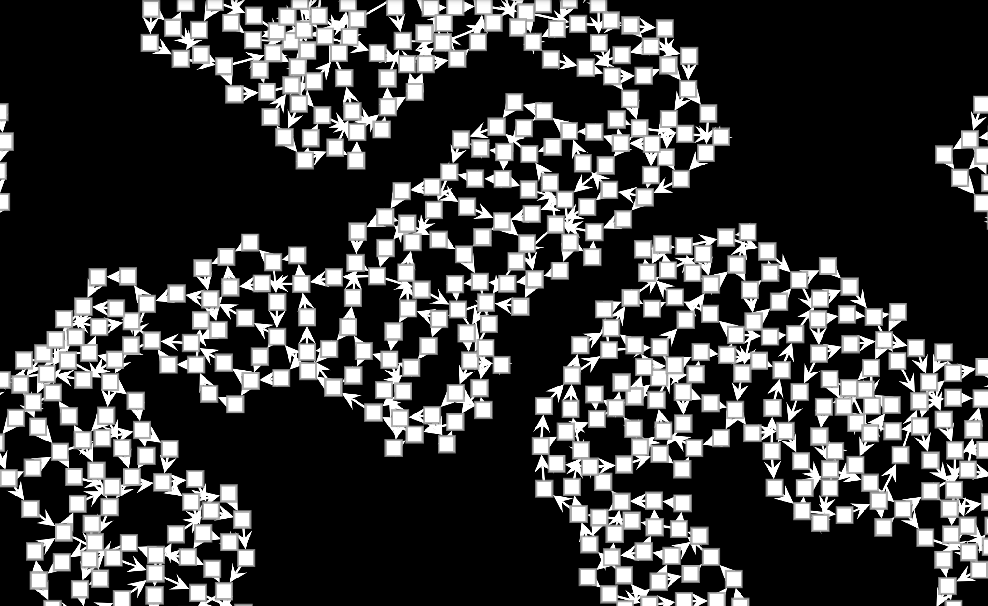
And real metagenomes
are very complex
And real metagenomes
are very complex
Notes:
Unlike the mRNA transcripts, however, the metagenome graph is very complex.
Here, each of the white boxes is a stretch of potential shared sequence, and arrows indicate overlaps.
As you can see, it's a truly remarkable mess of countless loops and branches.

Slide 37
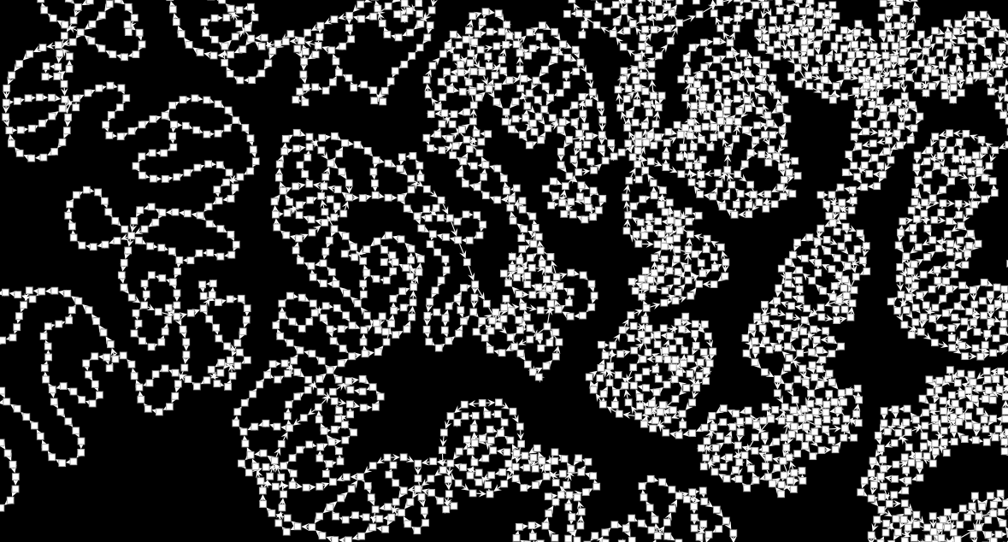
And real metagenomes
are very complex
And real metagenomes
are very complex
Notes:
And, that's just a tiny bit

Slide 38
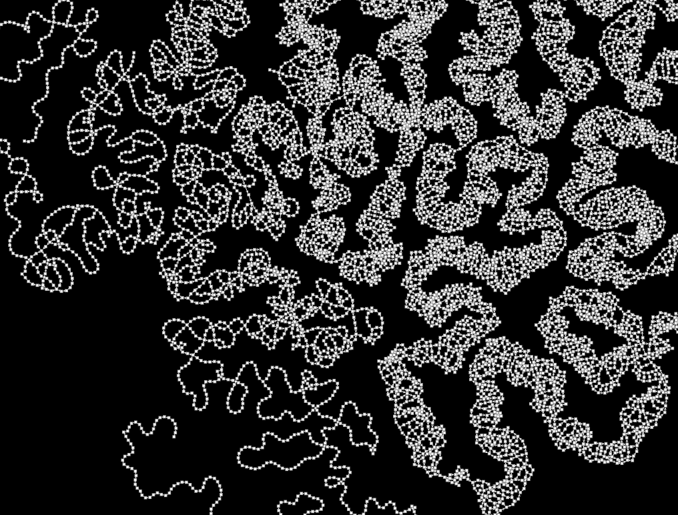
And real metagenomes
are very complex
Notes:
Of a tiny bit of the total graph
In reality it has millions to hundreds of millions of nodes and edges.
So how do we disentangle this hairball?

Slide 39
Real genomic sequences are paths on the graph
Notes:
We rely on one key feature of our assembly graph: real genomic sequences represent directed paths along the nodes.

Slide 40
Real genomic sequences are paths on the graph
Notes:
So, for instance, this might be one "true" path, which includes a cycle.

Slide 41
Real genomic sequences are paths on the graph
Notes:
And this could be another

Slide 42
Real genomic sequences are paths on the graph
Notes:
And this: a third
So we can enumerate all of the possible sequences, by enumerating all the possible paths

Slide 43
Lots of incorrect paths also exist…
Notes:
Unfortunately, not all possible paths are true paths. (And sequencing error exacerbates this problem)
For instance this sequence is also possible, but may not actually exist.
It might instead combine parts of two other sequences.

Slide 44
Lots of incorrect paths also exist…
How do we avoid these?
Notes:
So, once we have our graph, the big challenge is figuring out how to eliminate these imaginary paths

Slide 45
Lots of incorrect paths also exist…
How do we avoid these?
Standard Tools:
Filter out low-abundance sequences
Notes:
Standard assembly methods have two ways of solving this problem:
First, we can remove low abundance sequences to greatly simplify the graph.
This can leave us with the sequence of one dominant genome
However, it comes at the cost of potentially losing REAL diversity, filtering out sequences from less abundant strains.

Slide 46
Lots of incorrect paths also exist…
How do we avoid these?
Standard Tools:
Filter out low-abundance sequences
Fragment the graph when it's ambiguous
Notes:
Alternatively, we can break the graph up into unambiguous stretches, leaving us with shorter, but confidently assembled fragments,
This is also not really satisfying, however, since the more strain diversity in our samples the more fragmented our assembly becomes.

Slide 47

Untangling the hairball
Notes:
Basically these approaches cut up the hairball with scissors. Removing and fragmenting sequences.

Slide 48

Untangling the hairball
Notes:
However, what we'd really like is to extract long, strain-specific sequences without filtering or cutting them, more like disentangling genomes with computational tweezers.

Slide 49
StrainZip: Untangling the metagenome graph
Notes:
That's where the method that I've developed, called "StrainZip",
comes in.
StrainZip combines statistical modeling of sequencing depth across multiple shotgun metagenomic samples to disentangle the
overall graph.

Slide 50
How can we recover long, accurate genome sequences from short reads?
Notes:
To explain how it works, I'm going back to this cartoon of an assembly graph.

Slide 51
How can we recover long, accurate genome sequences from short reads?
Notes:
While it's challenging to find full-length, true paths, we can start by simplifying the problem:
We'll focus our attention on just one junction at a time.

Slide 52
Focus on just one junction at a time
Notes:
In this way we can ignore the global complexity, and focus on just the ambiguity about local paths.

Slide 53
Focus on just one junction at a time
Notes:
This particular junction (with two in and two out edges) has just four possible paths:

Slide 54
Focus on just one junction at a time
Notes:
Like this one.

Slide 55
Focus on just one junction at a time
Notes:
And this one

Slide 56
Focus on just one junction at a time
Notes:
And this one

Slide 57
Focus on just one junction at a time
Notes:
And finally the fourth.

Slide 58
Focus on just one junction at a time
Select local paths
Sparse linear regression across multiple samples
1
1
0
0
p_{1,1}
p_{1,2}
p_{1,3}
e_{1,1}
e_{1,2}
e_{1,3}
0
0
1
1
p_{2,1}
p_{2,2}
p_{2,3}
e_{2,1}
e_{2,2}
e_{2,3}
1
0
1
0
✖
p_{3,1}
p_{3,2}
p_{3,3}
≈
e_{3,1}
e_{3,2}
e_{3,3}
0
1
0
1
p_{4,1}
p_{4,2}
p_{4,3}
e_{4,1}
e_{4,2}
e_{4,3}
X
β
Y
Notes:
Using a statistical model of sequencing depth across multiple samples—what is essentially linear regression and model selection—we can accurately determine which local paths actually go through this junction.

Slide 59
Focus on just one junction at a time
Select local paths
Unzip
Notes:
Once we've identified these, we "unzip" this junction into separate segments for each path.

Slide 60
Focus on just one junction at a time
Select local paths
Unzip
Repeat
Notes:
Then we repeat this procedure at other junctions

Slide 61
Focus on just one junction at a time
Select local paths
Unzip
Repeat
Notes:
Unzipping and and slowly building up longer and longer linear sequences

Slide 62
Focus on just one junction at a time
Select local paths
Unzip
Repeat
Notes:
Until we've recovered large blocks of genomic sequence that can contain both shared and strain-specific sequence.

Slide 63
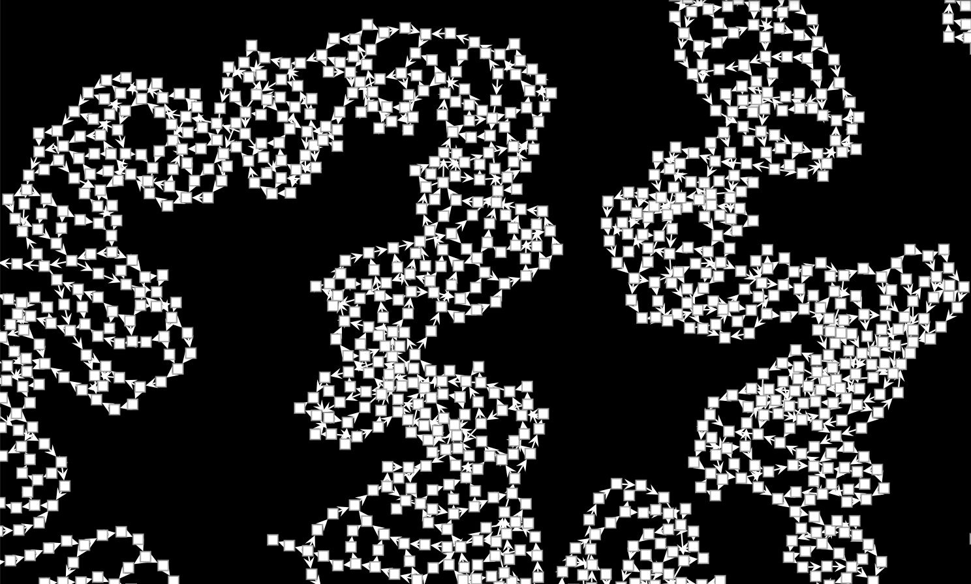
Notes:
On real data, this looks like taking our highly complex metagenome graph

Slide 64
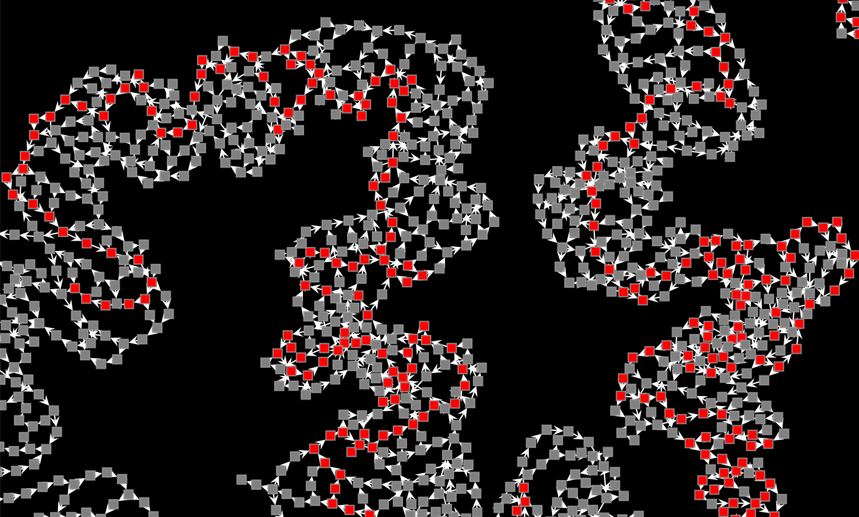
Notes:
And finding long, non-branching paths that go all the way through it.

Slide 65
Strain-resolved discovery
Notes:
So now that I've given you a taste for how it works.
What might we be able to do with it?
I need to warn you, this is research and progress, and
the results that I'm sharing are more of a teaser than a finished product.

Slide 66
Performance benchmarked on a complex, synthetic community
Notes:
I'll spare you the details, but I benchmarked StrainZip's accuracy with a collection of more than 250 samples from an in vitro experiment using a synthetic human gut microbial community.
Importantly, this community was highly complex, with more than 125 individual strains, including quite a few that are closely related. For the reasons I already described, this is normally very challenging for metagenomic methods to handle.

Slide 67
Antibiotic resistance genes are widespread in the gut microbiome
Notes:
But instead of focusing on benchmarking, I want to tell you a quick and preliminary story about antibiotic resistance genes in the microbiome.
While most of us are familiar with antibiotic resistance as a problem in infections,
I'm here to tell you that there are probably many strains in your gut right now that are
resistant to one or multiple antibiotics.
Sometimes this is inconsequential.
But sometimes these microbes are opportunistic pathogens,
and might become a problem after surgery or when immuno-compromised

Slide 68
Antibiotic resistance genes are widespread in the gut microbiome
Detection can inform treatment
Notes:
As a result, detecting these resistance genes and understanding which strains
harbor them is valuable, and could inform medical treatments.

Slide 69
Antibiotic resistance genes are widespread in the gut microbiome
Detection can inform treatment
No. of Unique Resistance Genes Found
1
49
10
Standard
Assembly
StrainZip
Notes:
By avoiding fragmentation and not filtering out sequences from low abundance strains in a model dataset,
StrainZip was able to annotate 20% more antimicrobial resistance genes than standard assembly methods.

Slide 70
Antibiotic resistance genes are widespread in the gut microbiome
Detection can inform treatment
catS
Notes:
One gene that was annotated in these StrainZip recovered paths encodes
Chloramphenicol acetytransferase,
which confers resistance to chloramphenicol

Slide 71
Antibiotic resistance genes are widespread in the gut microbiome
Detection can inform treatment
Can be carried in phage genomes
Caudoviricetes sp. A
Caudoviricetes sp. A
catS
capsid / tail proteins
Notes:
Interestingly, using the longer sequence assembled by StrainZip, we can find examples of this gene that are encoded right next to phage capsid and tail proteins.
This suggests that it is being carried in this particular, unnamed strain of caudoviricetes.

Slide 72
Antibiotic resistance genes are widespread in the gut microbiome
Detection can inform treatment
Can be carried in phage genomes
Long sequence fragments provide useful information
Caudoviricetes sp. A
Caudoviricetes sp. A
catS
capsid / tail proteins
sp. B
sp. B
Notes:
What's more, other paths recovered by StrainZip include these structural proteins, but not the catS gene
It's exciting to see that StrainZip is indeed able to recover both the catS encoding and non-encoding strain while assembling a single dataset.

Slide 73
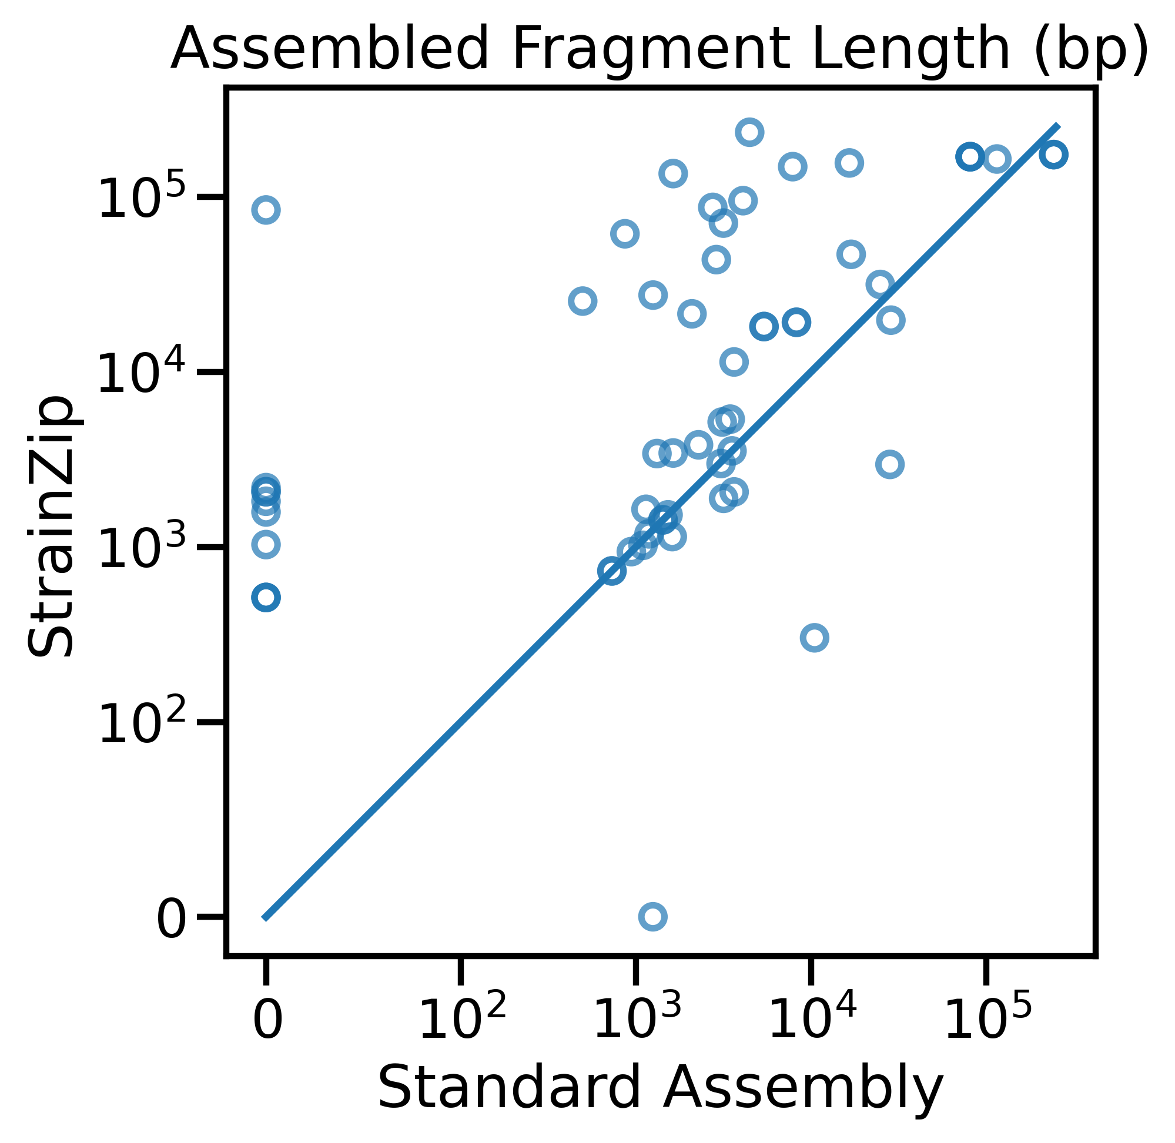
Antibiotic resistance genes are widespread in the gut microbiome
Detection can inform treatment
Can be carried in phage genomes
Long sequence fragments provide useful information
Notes:
This also demonstrates the value of long, strain-specific sequences.
Across all antibiotic resistance genes found in our data, we find that StrainZip on average assembles much longer sequence fragments
than standard approaches.
This suggests that StrainZip will be very helpful for understanding the strains and genomic neighborhoods that encode these genes, with ramifications for
human health.

Slide 74
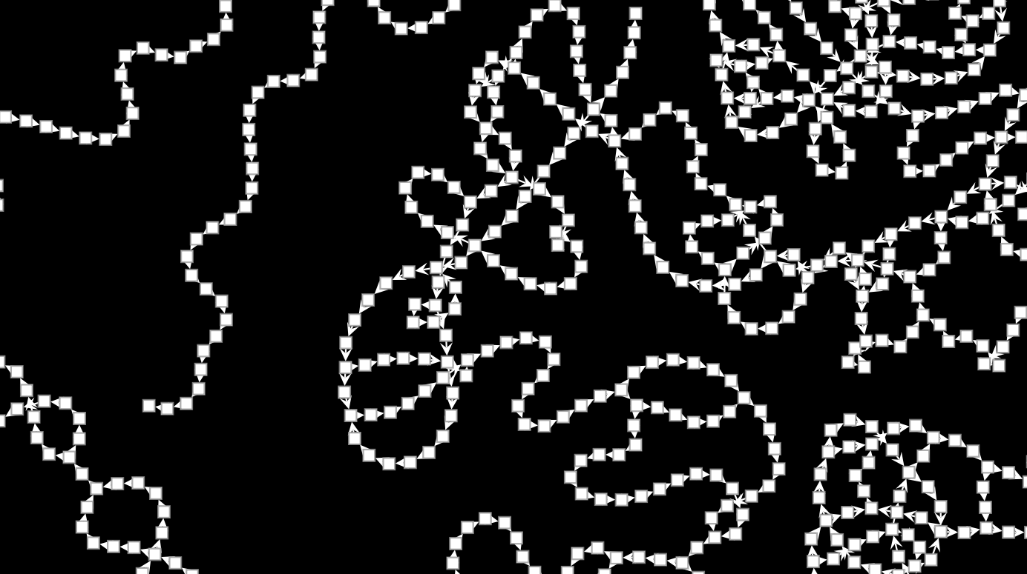
Complex Metagenome Graphs
StrainZip Iteratively Unzips Junctions
Strain-Resolved Metagenomics
Antibiotic Resistance Potential of Phage
Notes:
In conclusion, I think there are four key take-aways from my presentation
First, the metagenome assembly graph is enormously complex
Second, StrainZip "disentangles" the metagenome graph by iteratively unzipping junctions.
Third, this results in assembly of longer, strain-resolved sequences
And finally, we can use this to find interesting and potentially medically relevant examples of, e.g. antibiotic resistance genes encoded in prophage genomes
Thank you very much for your attention and I'd be happy to take questions with whatever time we have left.

Slide 75
Thank You!
Questions?

